Slide 1



Air Orange Airport Management System
Kirat Saran - 550246249
Pranav Addipalli - 482561915
Vinit Horakeri - 537701299

Slide 2
Objective
Allowing an admin working at Orange Air airports to use the Orange Air AMS app to do the following:
Store, Search, View and Update information about:
Flights
Employees
Airports
Airlines
Passengers
Tickets

Slide 3
Data Questions
Exploring Confirmed and Cancelled tickets
Updating passenger info
Updating employee’s job type
Looking up flight details
Looking up employee's work location
Finding passenger travel data
View basic information about employees, passengers, tickets and flights in the Power App

Slide 4
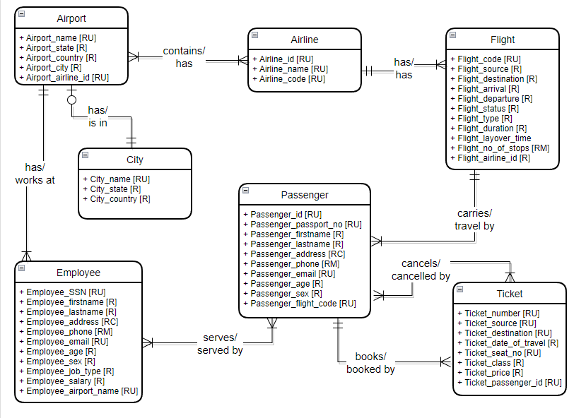
Conceptual Diagram

Slide 5
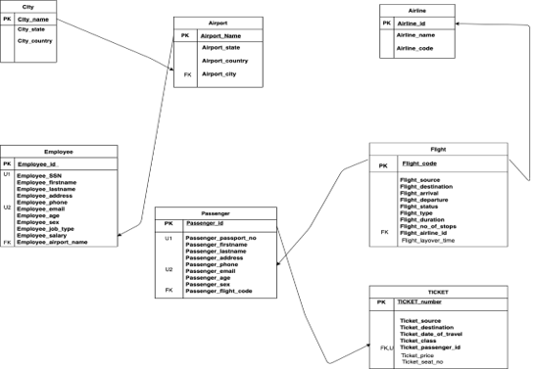
Logical Diagram

Slide 6
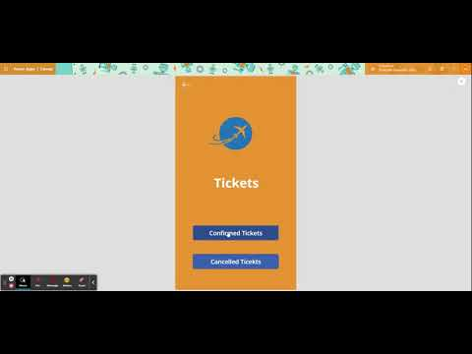
'Orange Air' Power App Demo

Slide 7
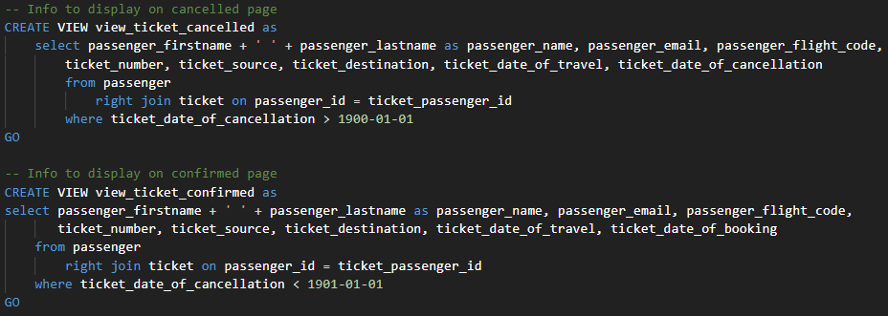
Exploring Confirmed and Cancelled Tickets
A user can use the AMS App to view passengers who have confirmed and cancelled tickets.
We have joined passenger and ticket columns

Slide 8
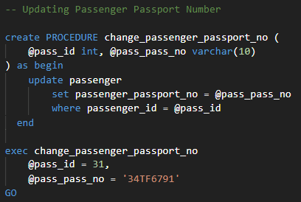
Updating Passenger Information
Admin can change the passport number of a traveler if required, using passenger_id
We have used a stored procedure.

Slide 9
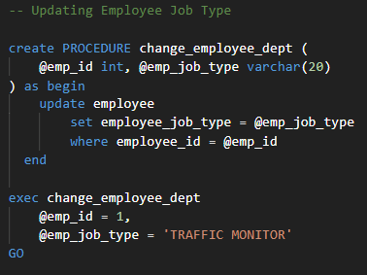
Updating Employee's Job Type
An employee's Job type can be changed by the admin using employee_id.
We have used a stored procedure.

Slide 10
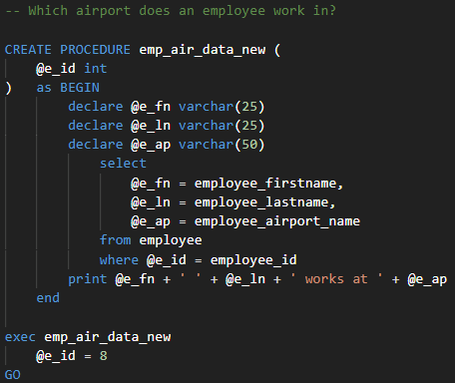
Looking Up Employee's Work Location
A user can look-up for an employee's work location by entering employee_id
We have used a stored procedure.

Slide 11
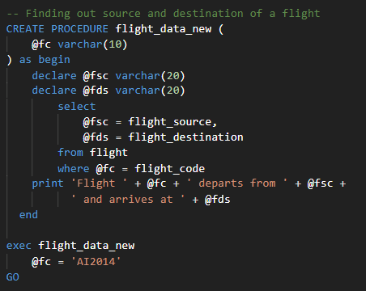
Looking Up Flight Details
When a user enters the flight_code, flight's source and destination are shown.
We have used a stored procedure.

Slide 12
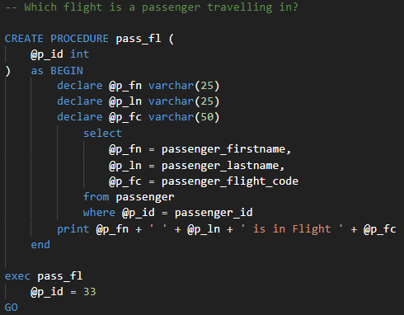
Finding Passenger Travel Information
Admin can check which flight a passenger is travelling, using the passenger_id
We have used a stored procedure.

Slide 13
Concepts Used
DDL Operations – CREATE, ALTER, DROP
DML Operations – INSERT, SELECT, UPDATE
Joins
Views
Closed Procedures
Assigning Multiple Columns to Variables
Power Apps
Up-Down Scripts

Slide 14
Questions
Thank You!

